Slide 1

Bapatla Engineering College Department of Information Technology
Project Review – II
on
FOOD CALORIE ESTIMATION SYSTEM USING COMPUTER VISION AND DATA SCIENCE
Under the Esteemed Guidance
of
Dr. P. Sreedhar _{M.Tech.,,Ph.D}
Presented By,
M.MadhuLatha - Y22AIT474
Y.Manikanta - Y22AIT530
A.D.S.G.Hima Bindu -Y22AIT401
G.Ravi Teja -Y22AIT426

Slide 2
Contents
Abstract
Problem Statement
Literature Review
Domain Knowledge
Architecture and Methodology
Implementation
Result
Conclusion
Future Scope

Slide 3
Abstract:
In recent years, maintaining a balanced diet and monitoring calorie intake has become increasingly important for a healthy lifestyle. However, traditional calorie tracking methods require manual input and are often time-consuming and inaccurate. To overcome these challenges, this project presents an AI-Based Food Calorie Estimation System using the Gemini API.The proposed system allows users to upload an image of food, which is then processed using the Gemini API for intelligent analysis. Instead of relying on locally trained machine learning models, the system leverages the capabilities of a large multimodal AI model to identify food items and estimate their calorie content. The API interprets the visual input, recognizes the type of food, and provides an approximate calorie value based on its understanding of nutritional information. The system is implemented using a web-based interface built with Flask, where users can easily upload images and receive instant results. Image preprocessing techniques are applied before sending data to the API to improve accuracy. The use of the Gemini API simplifies the development process by eliminating the need for complex model training while still achieving reliable predictions. This approach provides a fast, efficient, and user-friendly solution for calorie estimation. The system can be further enhanced by integrating real-time image capture, personalized diet v recommendations, and mobile application support, making it a practical tool for everyday health monitoring.
Keywords: Artificial Intelligence, Gemini API, Food Recognition, Calorie Estimation, Image Analysis, Multimodal AI, Flask, Web Application, Nutritional Analysis, Image Processing

Slide 4
Problem Statement
Traditional nutrition tracking depends on manual food logging and calorie estimation, which is often inaccurate and inconvenient. Users struggle with entering food items into databases or relying on generic diet charts, leading to inconsistent tracking and poor long-term adherence. Existing applications rarely provide intelligent analysis of food images or personalized health insights. They rely on keyword searches or templates that ignore portion size, dietary preferences, and fitness goals, making calorie counts and recommendations less reliable. To overcome these challenges, an AI-powered nutrition platform is needed. By analyzing food images, estimating nutritional values, and generating personalized health metrics such as BMI, water intake, and protein requirements, the system can reduce manual effort, improve accuracy, and help individuals achieve their dietary and fitness goals effectively.

Slide 5
Literature Review
Conventional nutrition tracking relies on manual food logging, which is tedious and often inaccurate. With advancements in Artificial Intelligence and Machine Learning, visionbased models now enable calorie estimation directly from food images, reducing human effort and improving accuracy. Research also shows that integrating health metrics like BMI and protein requirements with interactive dashboards enhances user engagement. Building on these developments, this project applies AI-powered food analysis and personalized recommendations to create a practical, user-friendly nutrition management system.

Slide 6
Domain Knowledge
Primary Domain:
Data Science – The project analyzes food image data and predicts calorie values using trained models and nutritional databases.
Supporting Domains:
• Artificial Intelligence (AI) – Enables automated food recognition and calorie estimation.
• Computer Vision – Extracts visual features like color, shape, and texture from images.
• Image Processing – Includes preprocessing steps such as resizing, normalization, and augmentation.
Application Area:
Healthcare & Nutrition Monitoring – Assists users in maintaining healthy dietary habits.

Slide 7
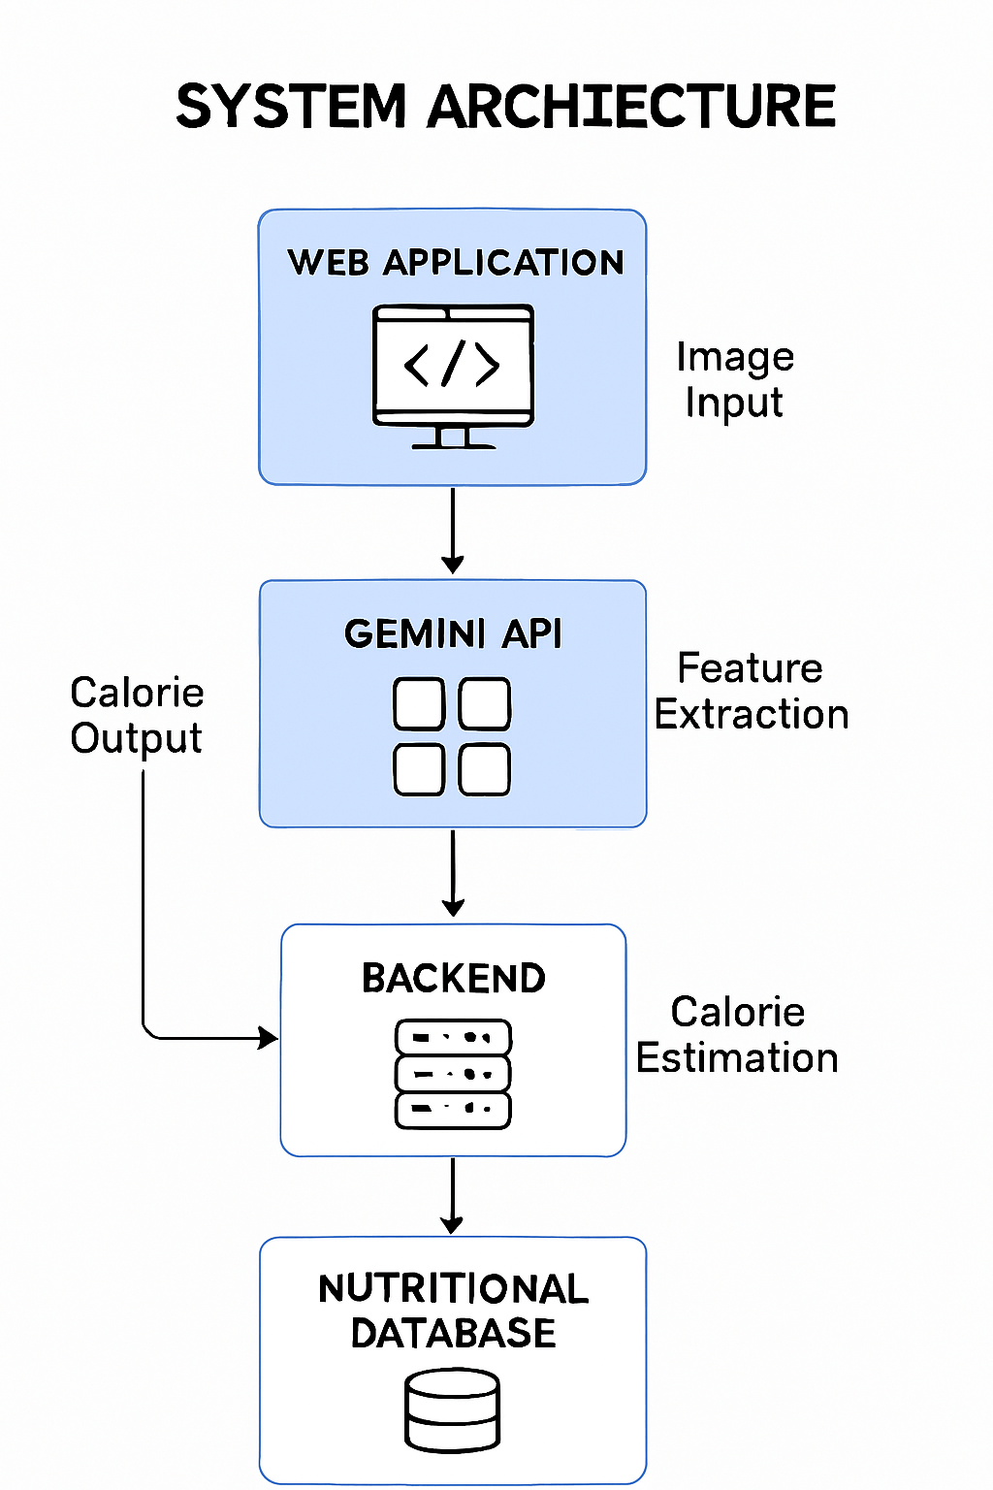
System Architecture:

Slide 8
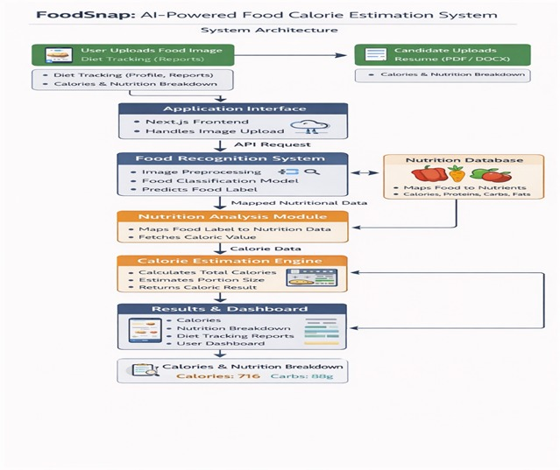
System Architecture

Slide 9
Methodology
1.Image Acquisition:User captures or uploads a food image using the application.
2.ImagePreprocessing: Resizing to fixed dimensions. Normalization of pixel values. Data augmentation (rotation, flipping, brightness adjustment).This improves model robustness under different lighting and angles.
3.Gemini Vision Model Innovation:
Gemini 2.0 flash or Gemini pro vision is called via Open API.
The model analyzes the image and returns structured insights.
4. Food Classification : The trained learning model classifies the image into a specific food category

Slide 10
Methodology
5.Nutritional Database Mapping : The predicted food category is mapped to a nutritional database containing calorie values of various food items.
6. Portion Estimation : The system estimates portion size to improve calorie accuracy.
7. Calorie Calculation : Total calorie value is computed based on food type and portion size.
Estimated Weight = (Detected Volume in ml) × (Density of food in g/ml)
Total Calories = (Calorie per 100g) × (Estimated Weight / 100)
8. Result Display : The final estimated calorie value is displayed through a user-friendly interface

Slide 11
System Requirements
Hardware Requirements :
The hardware requirements for the proposed system are minimal, as most of the processing is handled by the Gemini API. The system can run on standard computing devices without the need for high-end configurations.
Processor: Intel i3 or above
RAM:4GBorhigher
Storage: 256 GB HDD/SSD
Device: Desktop/Laptop

Slide 12
Software Requirements:
The software requirements include the programming environment, frameworks, and tools used to develop and run the application.
Operating System: Windows / Linux / macOS
Programming Language: Python
Framework: Flask (for web application)
Libraries: Requests, PIL (Image Processing)
API: Gemini API (for food recognition and calorie estimation) WebTechnologies: HTML, CSS (for frontend interface)
Browser: Google Chrome / Edge
Tools and Technologies Used :
The system utilizes modern tools and technologies to ensure efficient performance and ease of development.
Backend Development: Flask
Frontend Development: HTML, CSS
AI Service: Gemini API
Image Handling: PIL / OpenCV API
Communication: HTTP Request

Slide 13
Software Requirements:
The software requirements include the programming environment, frameworks, and tools used to develop and run the application.
Operating System: Windows / Linux / macOS
Programming Language: Python
Framework: Flask (for web application)
Libraries: Requests, PIL (Image Processing)
API: Gemini API (for food recognition and calorie estimation)
WebTechnologies: HTML, CSS (for frontend interface)
Browser: Google Chrome / Edge
Tools and Technologies Used :
The system utilizes modern tools and technologies to ensure efficient performance and ease of development.
Backend Development: Flask
Frontend Development: HTML, CSS
AI Service: Gemini API
Image Handling: PIL / OpenCV API
Communication: HTTP Request

Slide 14
Implementation
Algorithm:
Food Calorie Estimation using Gemini API
Step 1: Start the process
Step 2: Accept food image input from the user
Step 3: Perform image preprocessing (resize, format conversion)
Step 4: Send the preprocessed image to the Gemini API Step 5: Gemini API analyzes the image and identifies the food item
Step 6: Extract calorie-related information from the API response
Step 7: Process and format the output data
Step 8: Display the food name and estimated calorie value to the user
Step 9: Stop the process

Slide 15
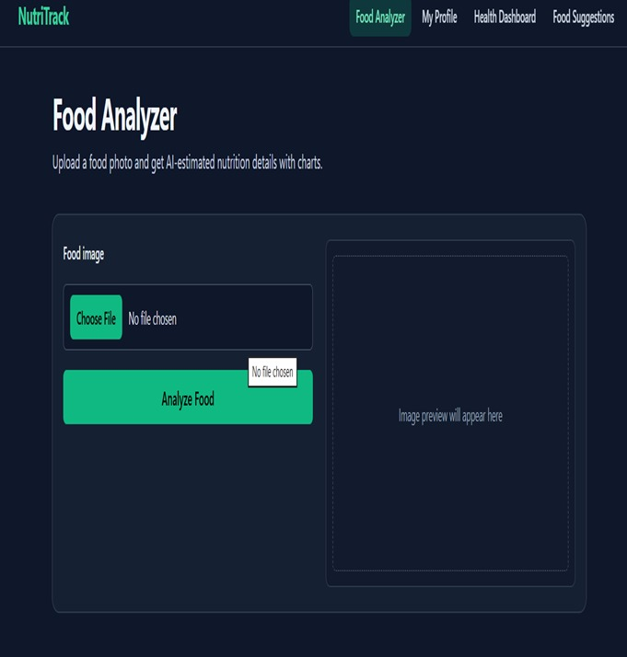
Result

Slide 16
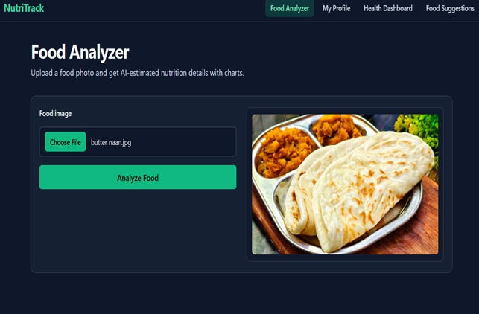

Slide 17
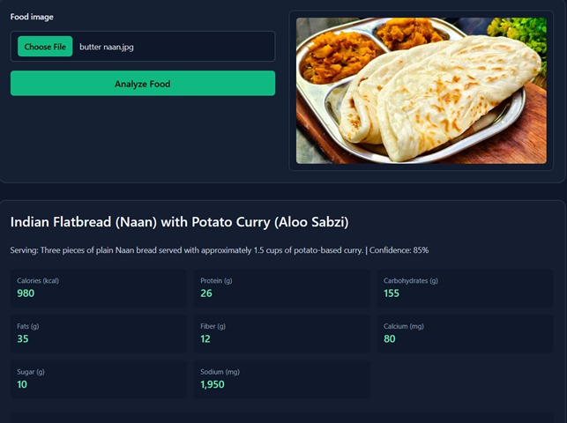

Slide 18
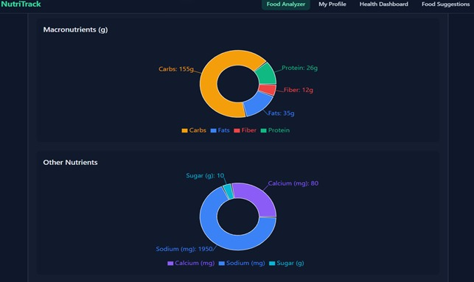
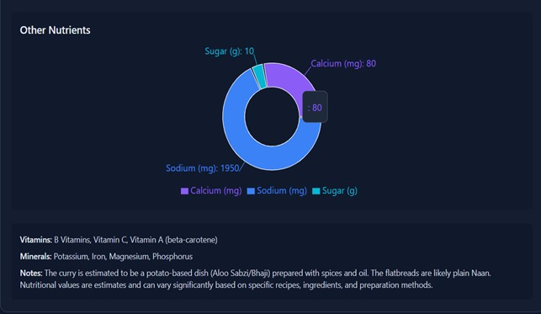

Slide 19
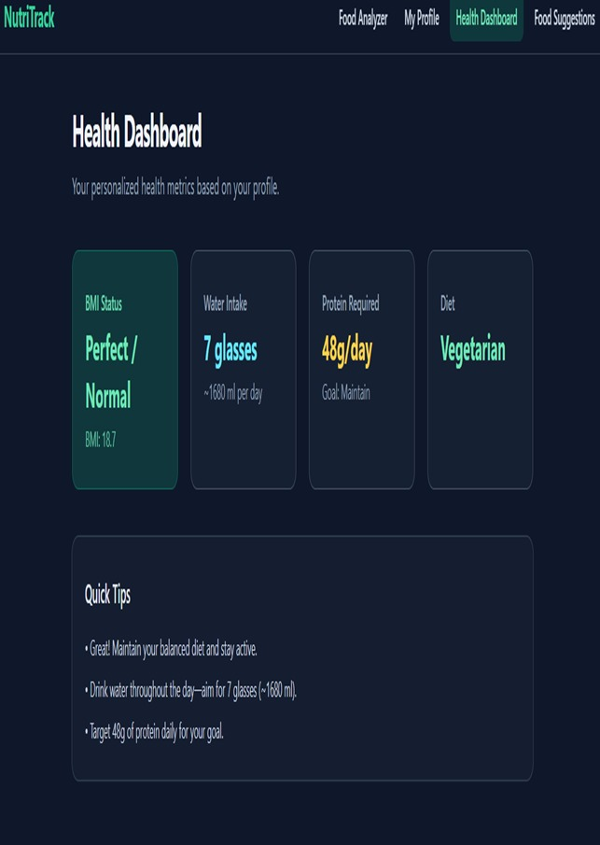

Slide 20
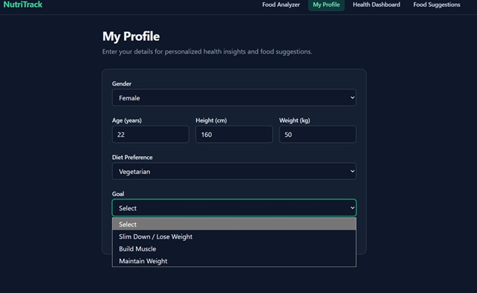
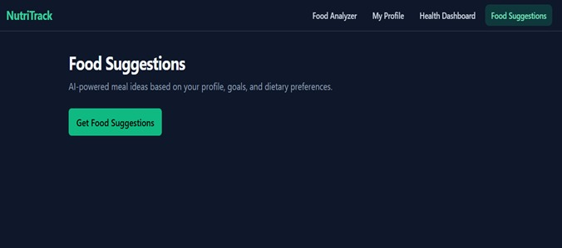

Slide 21
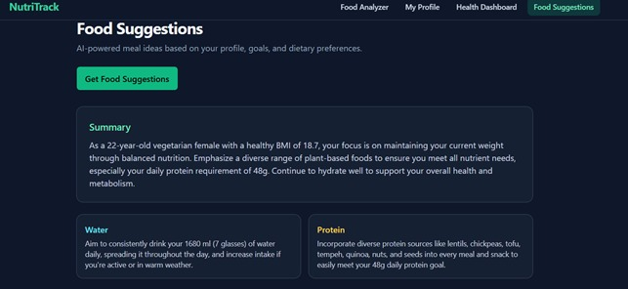
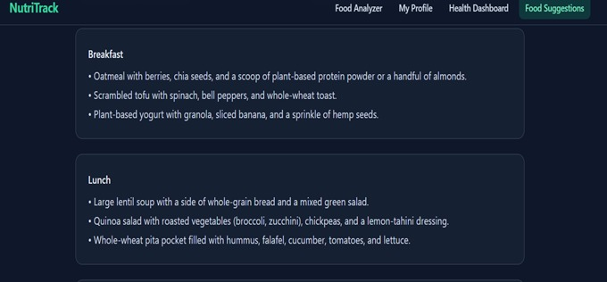

Slide 22
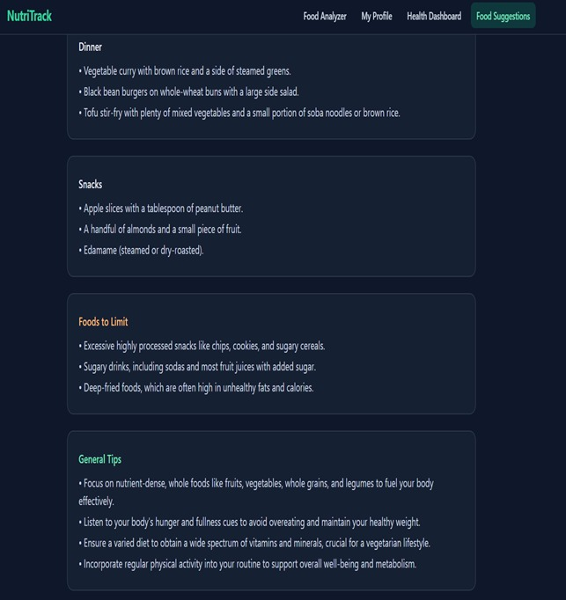

Slide 23


Slide 24


